Slide 1
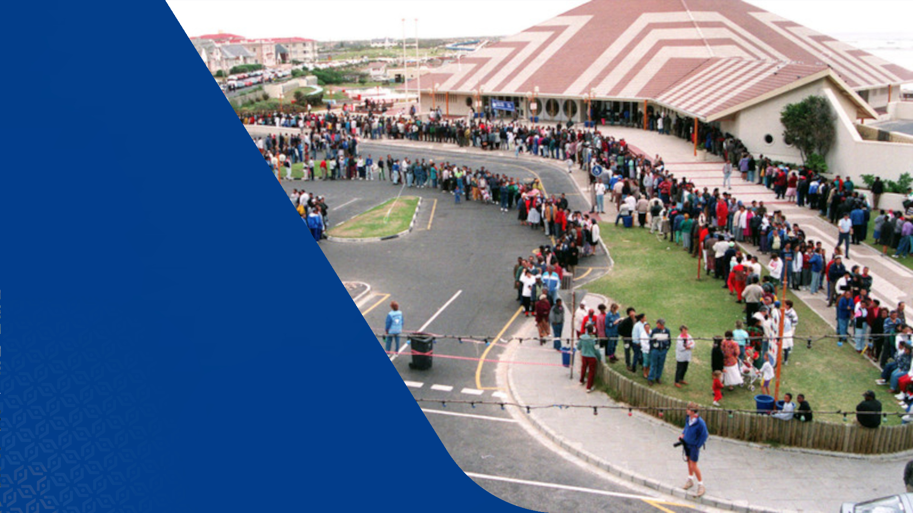

Slide 2
How Ready Will we be for the 2024 Elections?
Michael Atkins
September 2023

Slide 3
Problems and Concerns
Electoral Amendment Act
Assessing the IEC’s Readiness
Recommendations
Conclusions
Questions and Discussion

Slide 4
Section 1
Problems and Concerns

Slide 5
Problems and Concerns
How Ready Will we be for the 2024 Elections?
Democracy in decline
Risk factors for 2024 elections:
  Social and political tensions
  Changes to the Electoral Act
  Constitutional Challenges
  Errors and electoral fraud
  Disputed results

Slide 6
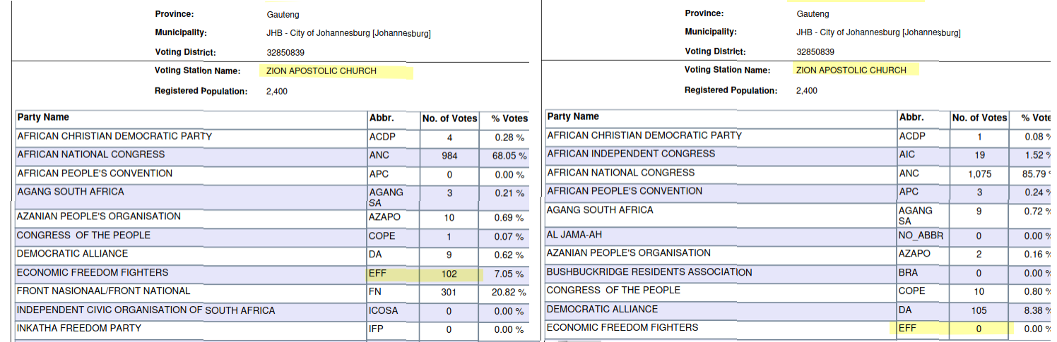
Accuracy of Results
How Ready Will we be for the 2024 Elections?

Slide 7
Accuracy of Results
How Ready Will we be for the 2024 Elections?

Slide 8
Section 3
Electoral Amendment Act

Slide 9
Electoral Amendment Act
How Ready Will we be for the 2024 Elections?
Independent candidates
Extra ballot
National Assembly:
  Regional ballot (provinces), including independent candidates
  PR Ballot
Provincial legislature ballot
High signature requirement

Slide 10
Electoral Amendment Act
How Ready Will we be for the 2024 Elections?
Independent candidates contest multiple elections
Recalculations favour the largest party:
  Vacancies
  Excess seats
Both ballots counted for National Assembly PR totals
Very successful independents distort provincial legislatures

Slide 11
Constitutional Court Challenges
How Ready Will we be for the 2024 Elections?
Independent Candidates Association (ICA):
  Seats available in Regional Elections
  Affects the Quota determining votes required for Independent Candidates
One South Africa (OSA):
  Signature Requirement
  Recalculation

Slide 12
ICA Remedy
How Ready Will we be for the 2024 Elections?
350 seats available in regional elections:
  Near-parity with parties in votes required per seat
  Small chance of single-seat overhang
Overhang is catered for in local government elections

Slide 13
OSA Remedy
How Ready Will we be for the 2024 Elections?
1,000 signatures to contest elections
Recalculation replaced by highest remainder in original election

Slide 14
OSA Remedy
How Ready Will we be for the 2024 Elections?
“Let us go to the previous election. Every election always has a person where the cut-off point happens with them, they always have a person who could have got in if the one above did not beat them by votes. So there will always be a person who was about to [be elected]. They said, we go and look to that person, whether it is a political party or an independent. That person must come in, who was just hanging. ... That seat must be available to the person who nearly got in, whether that person represented a political party or an independent. And that’s how it was resolved.”
- Minister of Home Affairs to NCOP, 2 November 2022

Slide 15
Section 4
Assessing the IEC’s Readiness

Slide 16
Assessing the IEC’s Readiness
How Ready Will we be for the 2024 Elections?
Budget Cuts
Long Ballot Papers
Staff Recruitment and Training
Management of Signatures
Voting Outside of own Voting Station – s 24A

Slide 17
Assessing the IEC’s Readiness
How Ready Will we be for the 2024 Elections?
“We made a submission to the National Treasury yesterday (Friday) and we are hoping for a positive answer. The short of it is that barring any further cuts, we are sufficiently funded to deliver the mandate next year. National Treasury has never been difficult with us being funded not to the extent that we like.”
- Masego Sheburi, 16 Sept

Slide 18
Section 5
Recommendations

Slide 19
Recommendations
Readiness for 2024 Elections
Elections culture:
  Importance of accuracy
  Agency of citizens
IEC:
  Improved transparency
  Openness of data and procedures
Media
Political parties
Improvements in electoral rules

Slide 20
Section 6
Conclusions

Slide 21
Conclusions
How Ready Will we be for the 2024 Elections?
The IEC has successfully navigated some very difficult elections
There are risks:
  Delays in voting and counting
  Electoral fraud, and claims of fraud
Some processes may be degraded
There are concerns over accuracy of results
There is a need for greater transparency

Slide 22
Thank you
Michael Atkins
Email: atkins@itrend.co.za
X: @atkinsmike1

